Slide 1

Disparities in Provision/ Access to “Healthcare” Worldwide

Slide 2

The World Health Organization (WHO), have undertaken a few initiatives aimed at improving health globally.
These initiatives include:
Global Action Plan for Healthy Lives and Well-being for All
WHO Public Health and Social Measures Initiative
UN Decade of Action on Nutrition

Slide 3

AGENDA
Is there a correlation between the amount the government allocates for healthcare from their budget to overall life expectancy
Which country has the highest prevalence of wasting in children under 5 years of age
Which country has the lowest prevalence of wasting in children under 5 years of age
What are the top 10 countries with the lowest proportion of the population using safely managed drinking-water services
What are the top 10 countries with the highest proportion of the population using safely managed drinking-water services

Slide 4
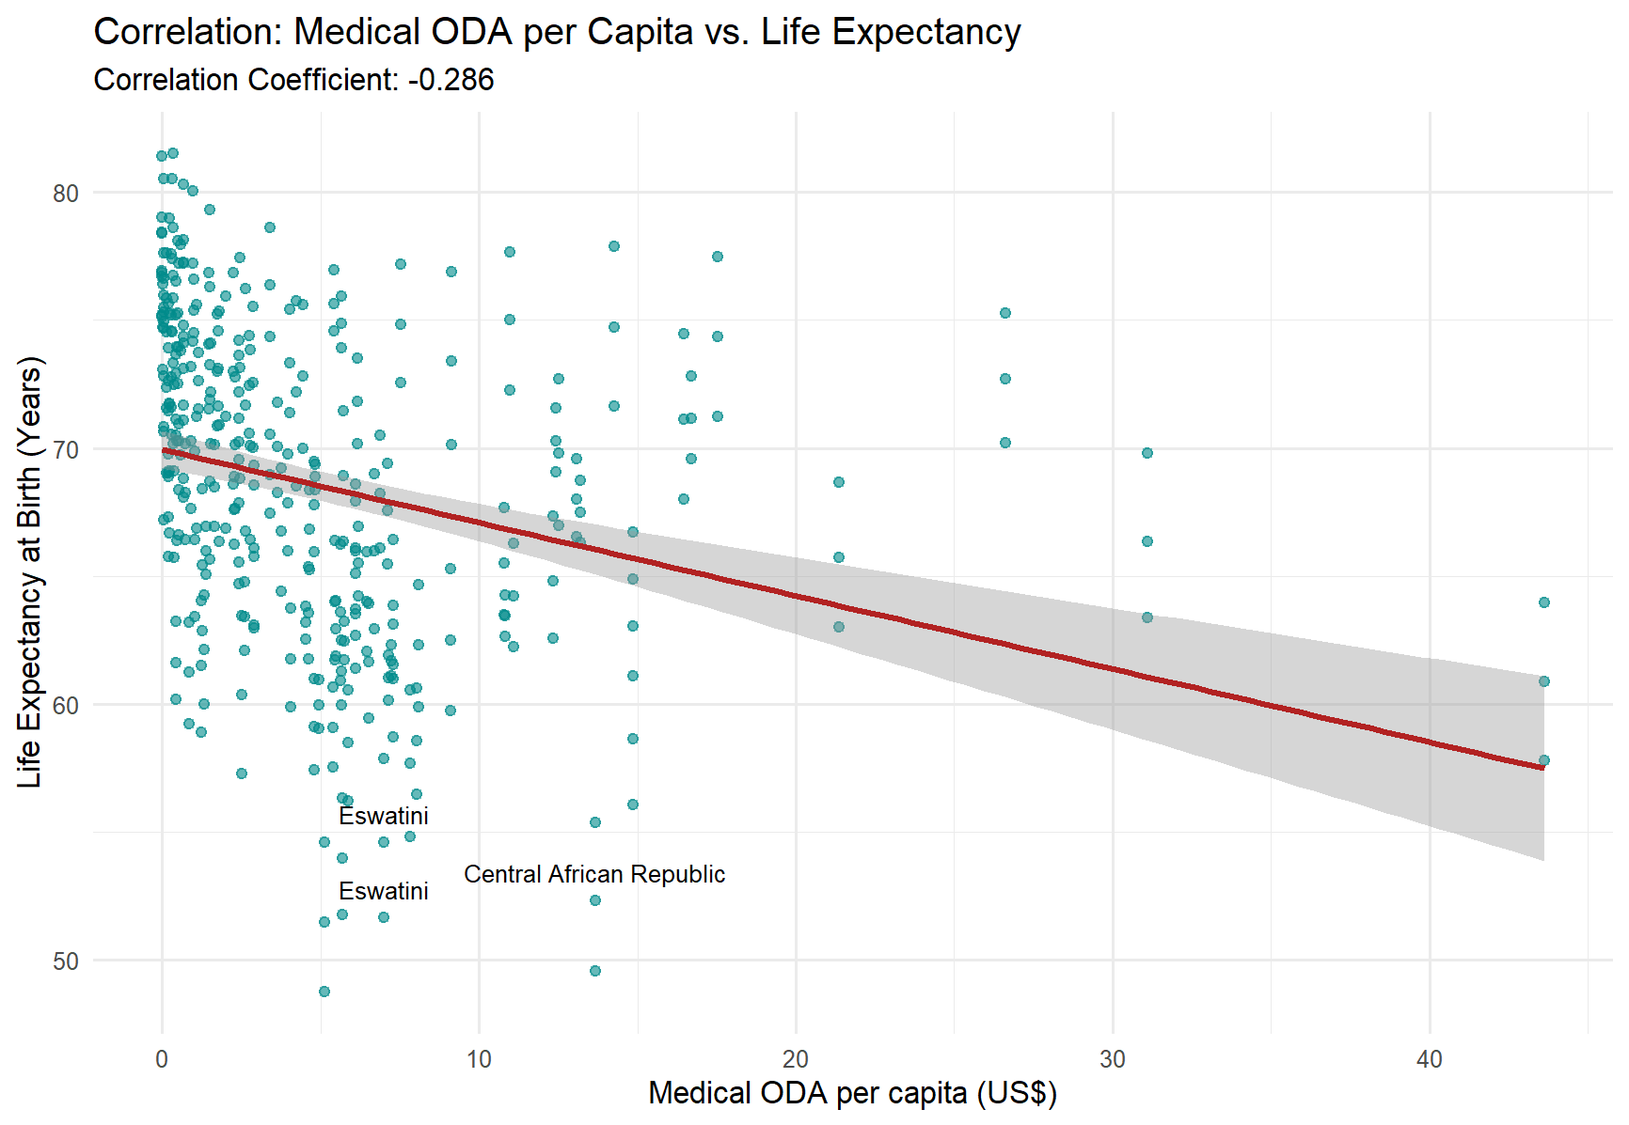

Slide 5
Is there a correlation between the amount the government allocates for healthcare to overall life expectancy
Correlation Coefficient: -0.286
Indicators Used:
Life Expectancy
Total net official development assistance to medical research and basic health sectors per capita (US$), by recipient country"
Expected Result :
There would be some sort of correlation between receiving aid and having a low life expectancy after birth and needing to receive aid for Healthcare.

Slide 6
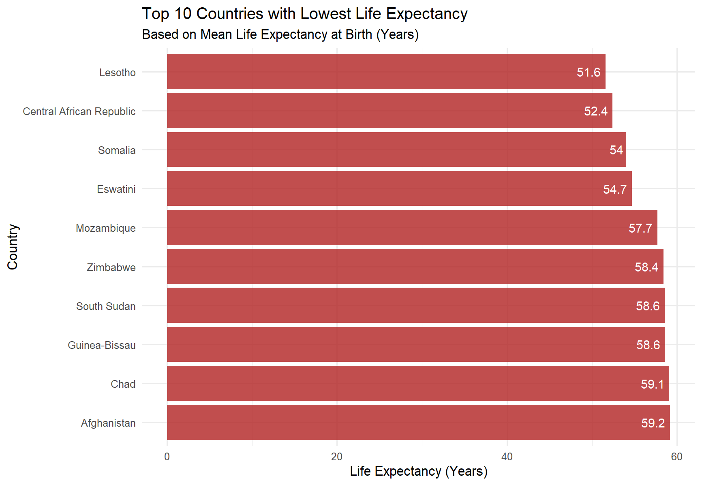

Slide 7
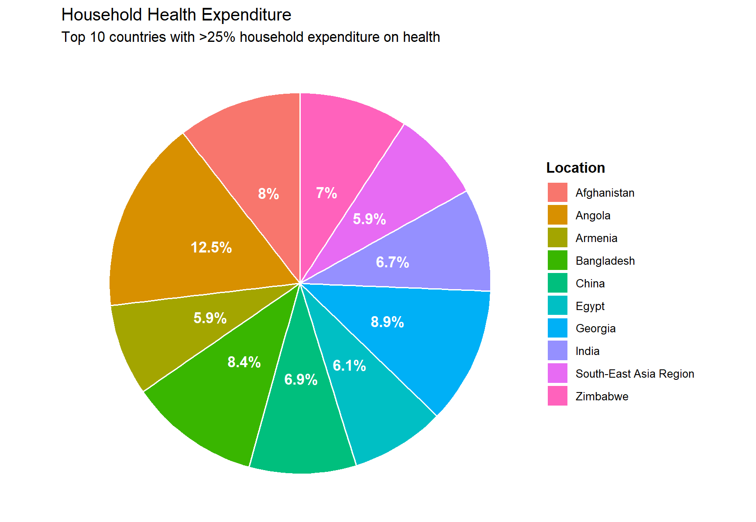
Angolans spend the most of their income on healthcare, They spend roughly 12.5% of their income while Georgians spend 8.9%.

Slide 8
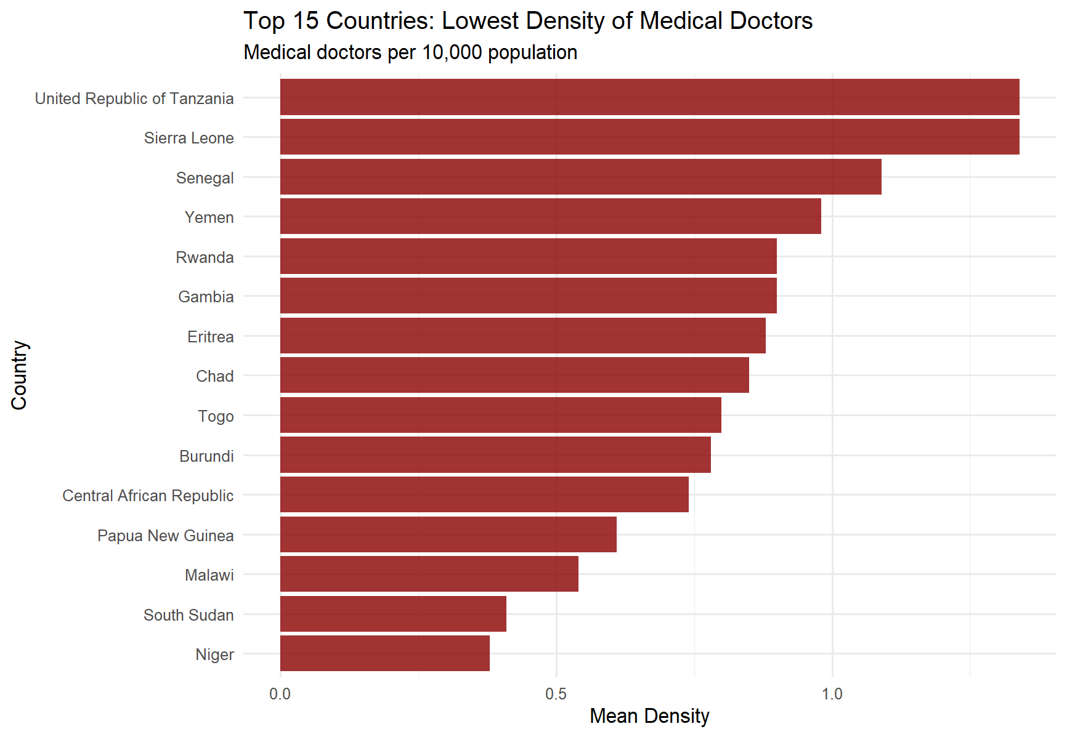
No correlation between high cost location and low density of doctors Location,
Countries with the lowest density of Medical Doctors are:
- Niger
South Sudan
Malawi
Papua New Guinea

Slide 9
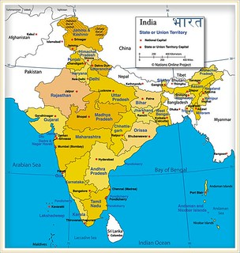
Which country has the highest prevalence of wasting in children under 5 years of age
India has the highest incidence of wasting in children under the age of 5 years.
According to the data found in a UNICEF study, the patterns for incidence of wasting and severe wasting were similar to prevalence. They linked the issue with lower maternal education, poor nutritional status of the mother, Caesarean section, low birthweight, and male children were associated with higher risk of wasting.
Wasting during the first six months of life was found to be an independent risk factor for wasting at 12 and 24 months of age.

Slide 10
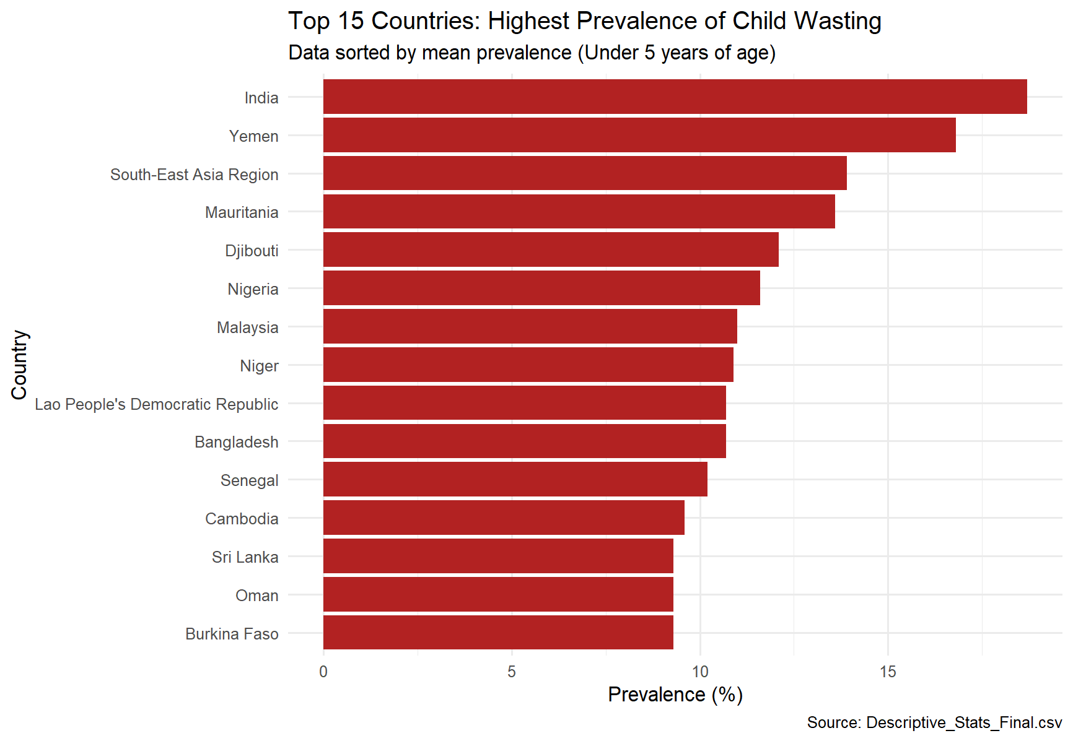

Slide 11

Which country has the lowest prevalence of wasting in children under 5 years of age
The United States of America had the lowest incidence of wasting in Children under the age of 5 years in 2022.
The United States reportedly provided access to maternal health care services, access to pre and antennal clinics and implemented policies and programs to support nutritional health.

Slide 12
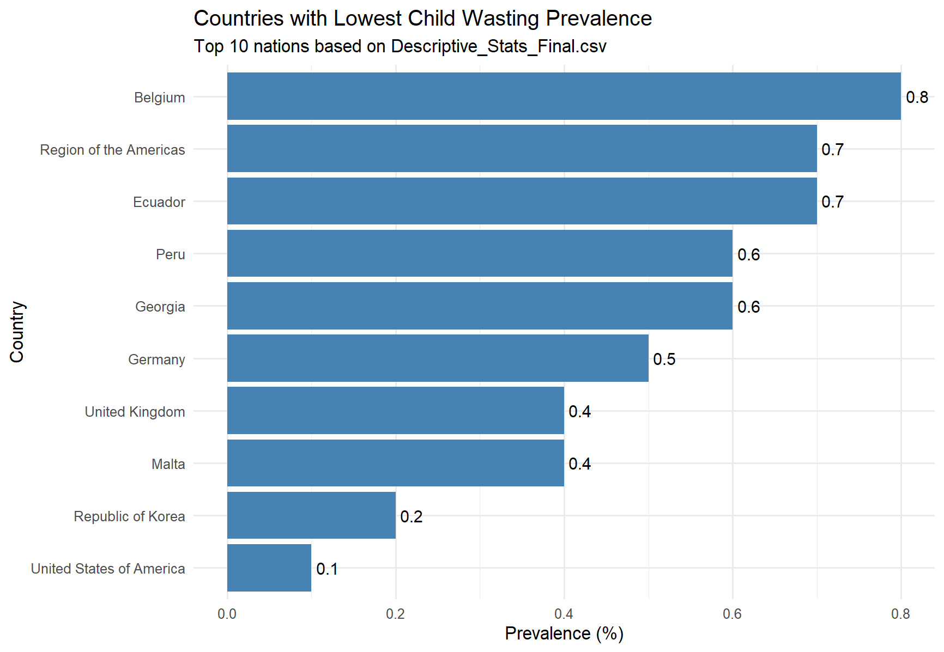

Slide 13
Which country has the lowest Access to safe Drinking water
These are all countries with low GDPs, disparities in income distribution and are developing countries that rely on aid for certain health improvements.
Malawi
Nepal
Kiribati
Ethiopia
Democratic Republic of Congo

Slide 14
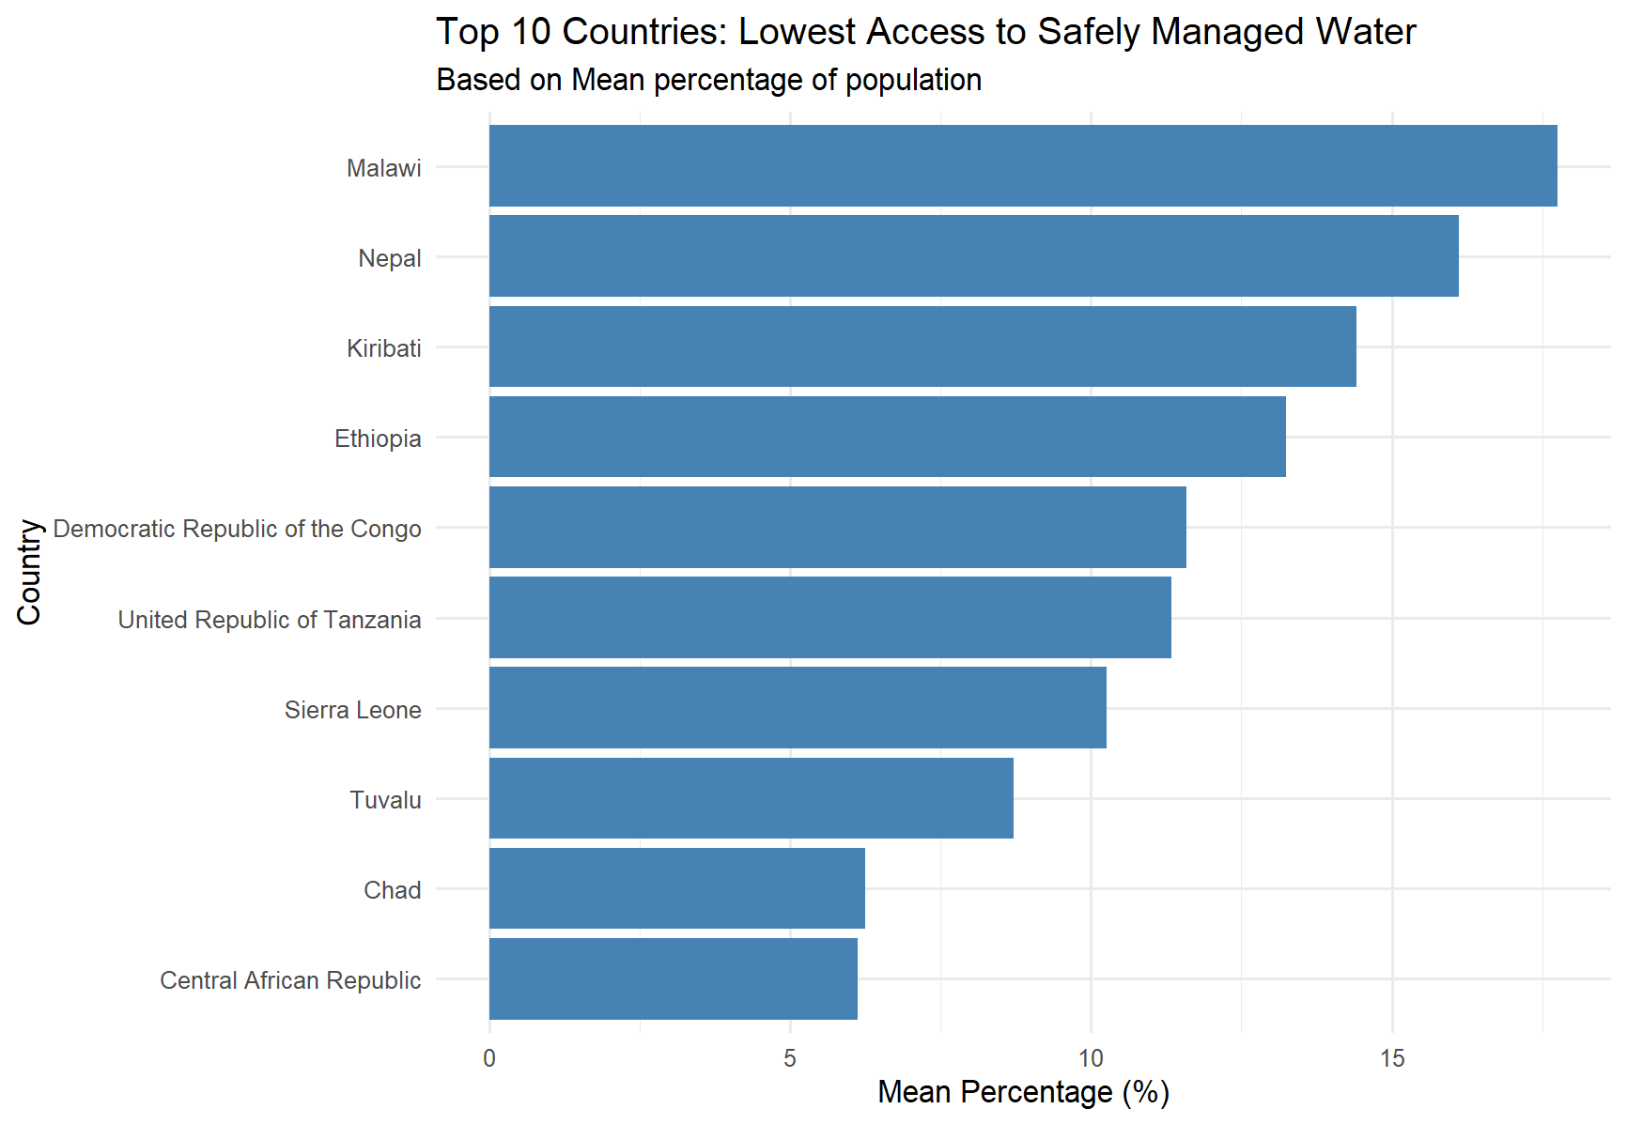

Slide 15

What are the top 10 countries with the highest proportion of the population using safely managed drinking-water services
The countries in the developed world all have nearly 100% access to safe drinking water.
They Include:
Singapore
New Zealand
Iceland
Denmark

Slide 16
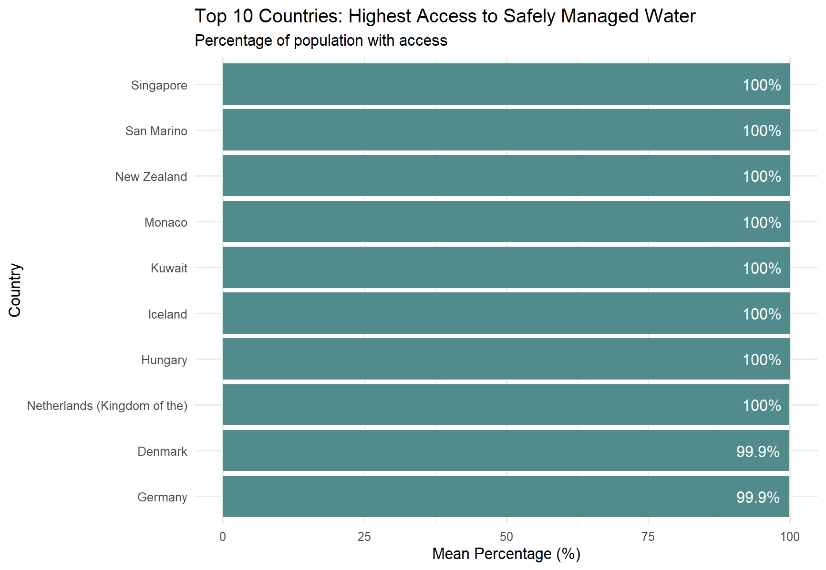

Slide 17

Why look at wasting?
The percentage of children with a low height-for-age indication of poor environmental conditions or long-term restriction of a child's growth potential. The percentage of children who have low weight-for-age (underweight) can reflect wasting (i.e. low weight-for-height), indicating acute weight loss or stunting, or both. Thus, underweight is a composite indicator that may be difficult to interpret

Slide 18
Indicators
It was expected that the different indicators, together could be used to draw a conclusion and who some countries are facing the health issues they are facing, and we would be able to recommend a remedy on how they can fix the issue base on data to improve standard of living in the respective country(s.)
It was expected that the different indicators:
Healthy life expectancy at birth (years)
Population with household expenditures on health > 10% of total household expenditure or income (%)
Population with household expenditures on health > 25% of total household expenditure or income (%)
Life expectancy at birth (years)
Density of medical doctors (per 10 000 population)
Total net official development assistance to medical research and basic health sectors per capita (US$), by recipient country
Prevalence of wasting in children under 5 (%)
Proportion of population using safely-managed drinking-water services (%)

Slide 19
Analysis
While a lot of countries have their own issues, they all seem to be doing worse in their own indicator of standard of living.
The Central African Republic has the lowest access to safe drinking water.
India has the highest prevalence of child wasting.
Lesotho has the lowest life expectancy after birth with an average of 51.6 years.
All of the countries captured in the data are at different stages of development, have their own internal problems and their respective goals as a country.
There is no single factor that the WHO have collected that can be pinpointed and say for sure this is the reason who this country has this particular problem they are facing.

Slide 20
Reference
Analysis of wasting and severe wasting and its associated risk factors among under-5 children in India | Knowledge
Malnutrition in children
content

Slide 21

THANK YOU
Brita Tamm
502-555-0152
brita@firstupconsultants.com
www.firstupconsultants.com

